Slide 1
Experiment – 1
25070521130
1.1.1 Area of Circle
Algorithm
STEP 1 : Start
STEP 2 : Input radius
STEP 3 : Calculate
area = 3.14*radius*radius
STEP 4 : Print area
STEP 5 : Stop
Flowchart
Start
Input radius
area = 3.14*radius*radius
Print area
Stop

Slide 2
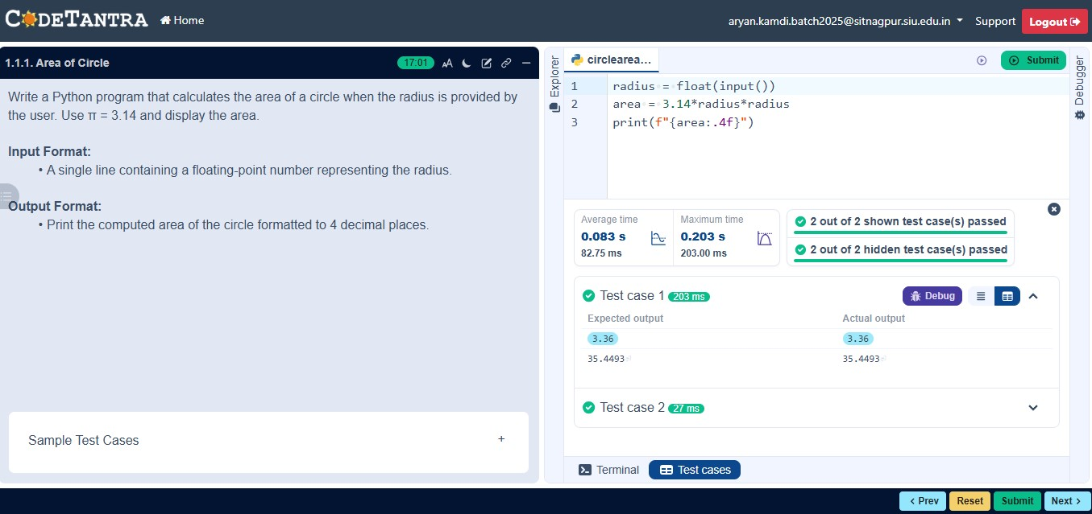
Code
25070521130
radius=float(input())
area=3.14*radius*radius
print(f"{area:.4f}")
Execution

Slide 3
Experiment – 1
25070521130
1.1.2 Area of Rectangle
Algorithm
STEP 1 : Start
STEP 2 : Input length, breath
STEP 3 : Calculate
area = length*breath
STEP 4 : Print area
STEP 5 : Stop
Flowchart
Start
Input length, breath
area = length * breath
Print area
Stop

Slide 4
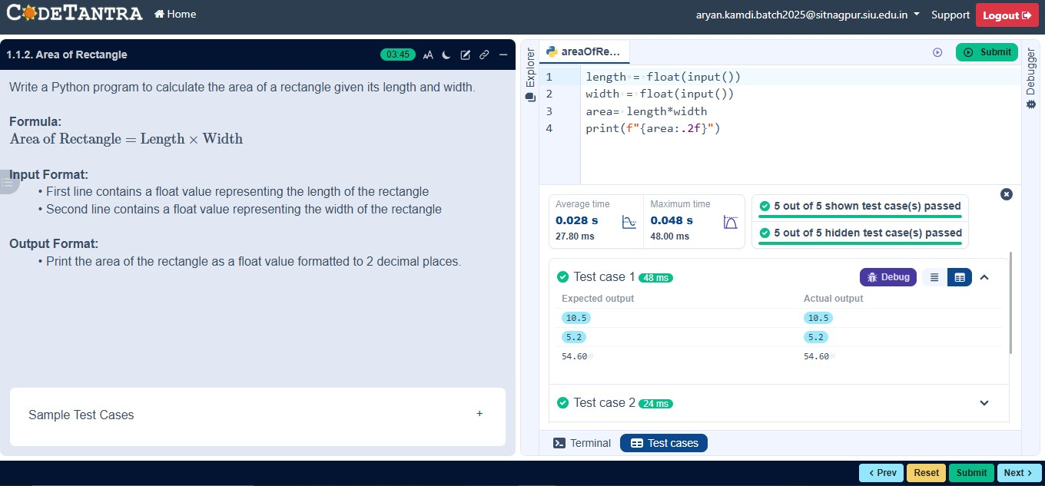
Code
25070521130
length = float(input())
breath = float(input())
area = length*breath
print(f"{area:.2f}")
Execution

Slide 5
Experiment – 1
25070521130
1.1.3 Calculate Area of the Square
Algorithm
STEP 1 : Start
STEP 2 : Input side_length
STEP 3 : Calculate
area = side_length * side_length
STEP 4 : Print area
STEP 5 : Stop
Flowchart
Start
Input side_length
area = side_length * side_length
Print area
Stop

Slide 6
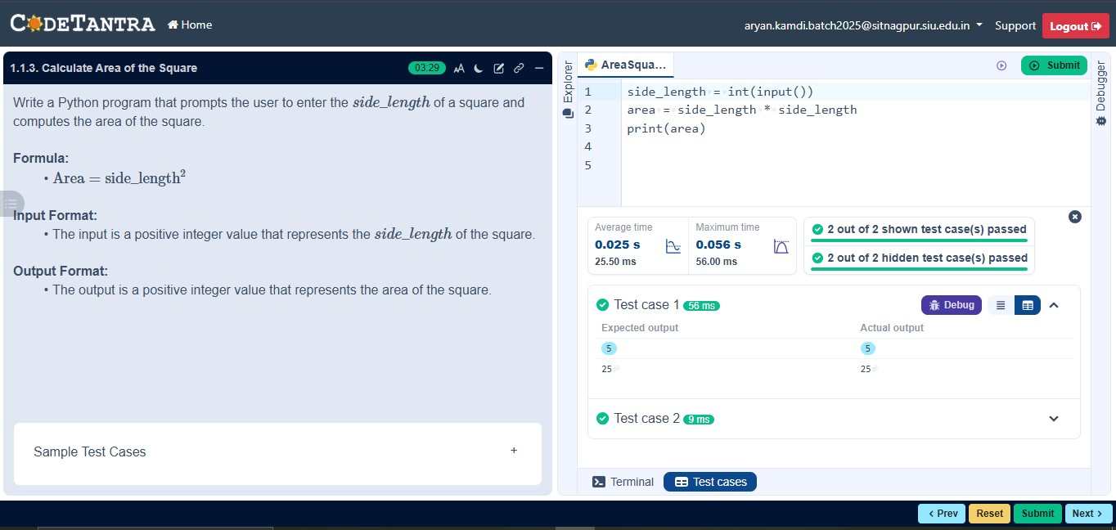
Code
25070521130
side_length=int(input())
area=side_length*side_length
print(area)
Execution

Slide 7
Experiment – 1
25070521130
1.1.4 Area of Triangle
Algorithm
STEP 1 : Start
STEP 2 : Input base, height
STEP 3 : Calculate
area = 0.5*base * height
STEP 4 : Print area
STEP 5 : Stop
Flowchart
Start
Input base, height
area = 0.5 * base * height
Print area
Stop

Slide 8
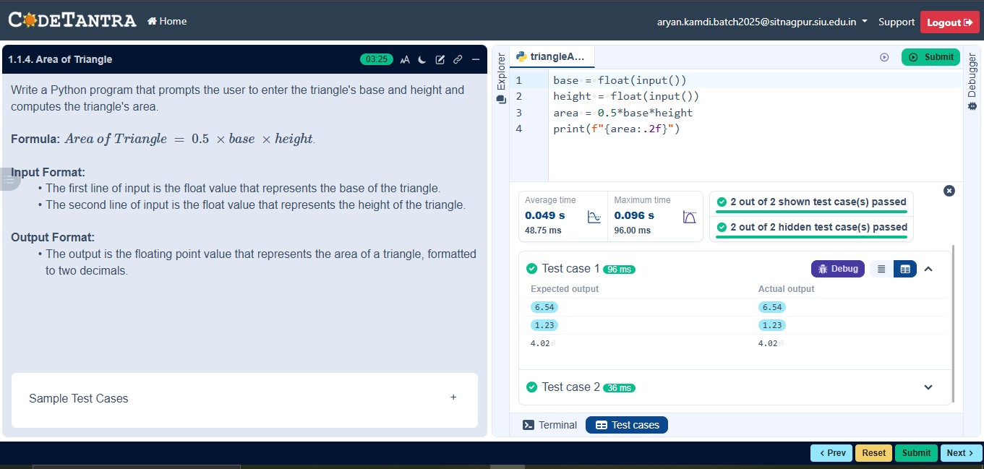
Code
25070521130
base=float(input())
height=float(input())
area=0.5*base*height
print(f"{area:.2f}")
Execution

Slide 9
Experiment – 1
25070521130
1.1.5 Student Pass or Fail status
Algorithm
STEP 1 : Start
STEP 2 : Input marks
STEP 3 : Check condition
If marks ≥ 40
Print "Pass"
Else
Print "Fail"
STEP 4 : Stop
Flowchart
Start
Input marks
If marks >= 40
Yes
No
Print “Pass”
Print “Fail”
Stop

Slide 10
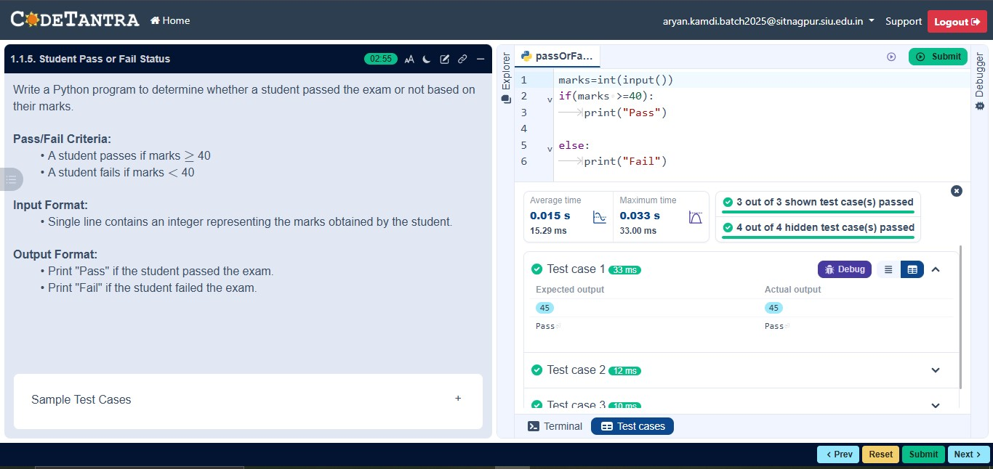
Code
25070521130
marks=int(input())
if marks>= 40:
print("Pass")
else:
print("Fail")
Execution

